Slide 1

lab usability study
Notes:
Intro & team - 30 sec
Overview - 30 sec
Prototype changes - 30 sec
Participants - 30 sec
Apparatus - 30 sec
Procedure - 1 min
Tasks - 30 sec
Test measures - 30 sec
Results - 1.5
Discussion - 5 min (4-6 changes)
Summary - 30 sec

Slide 2
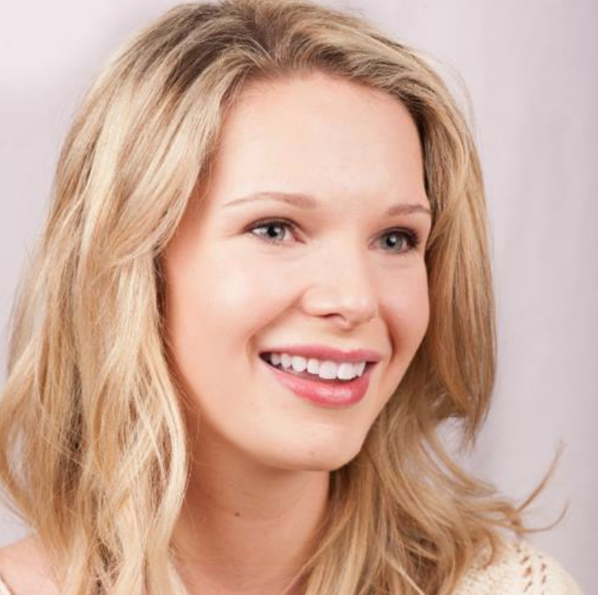
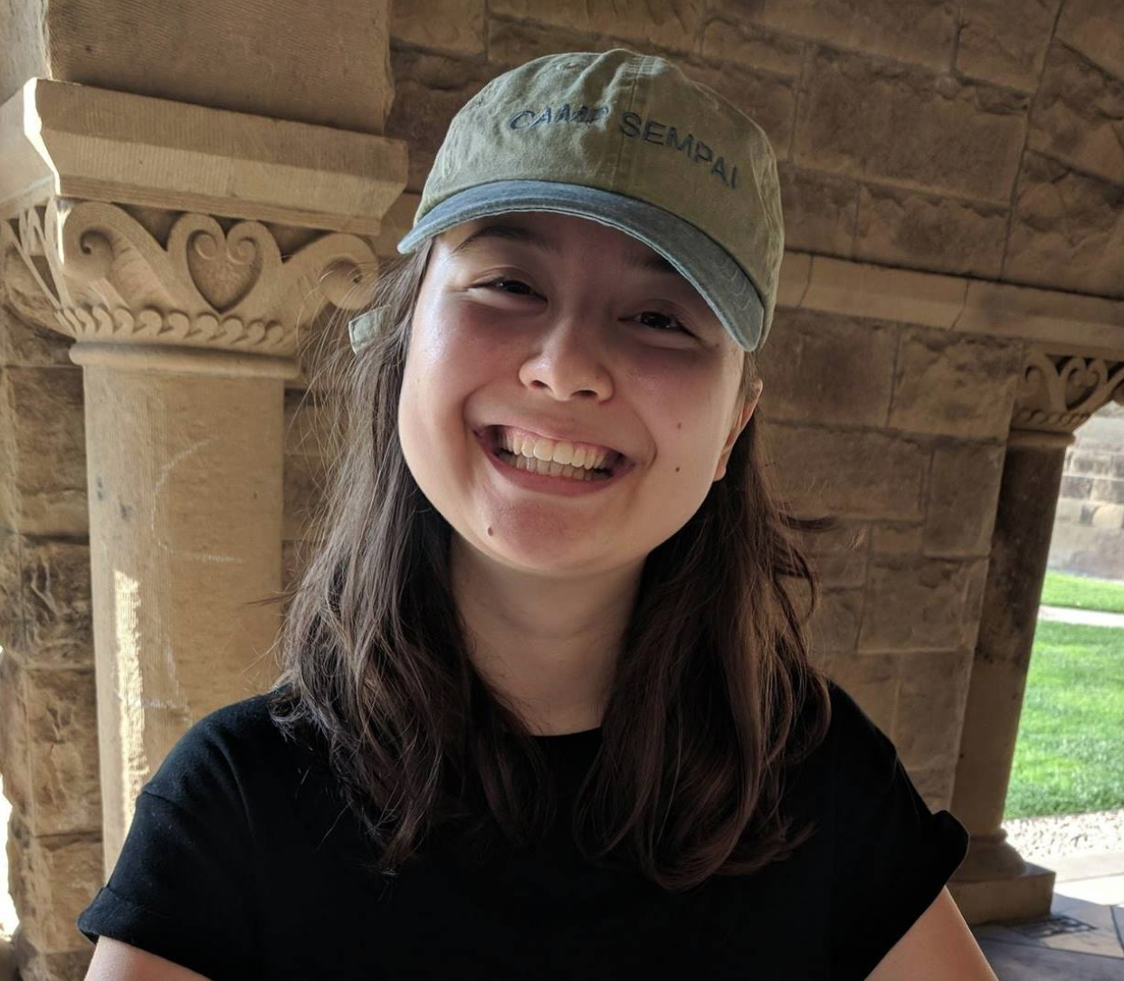
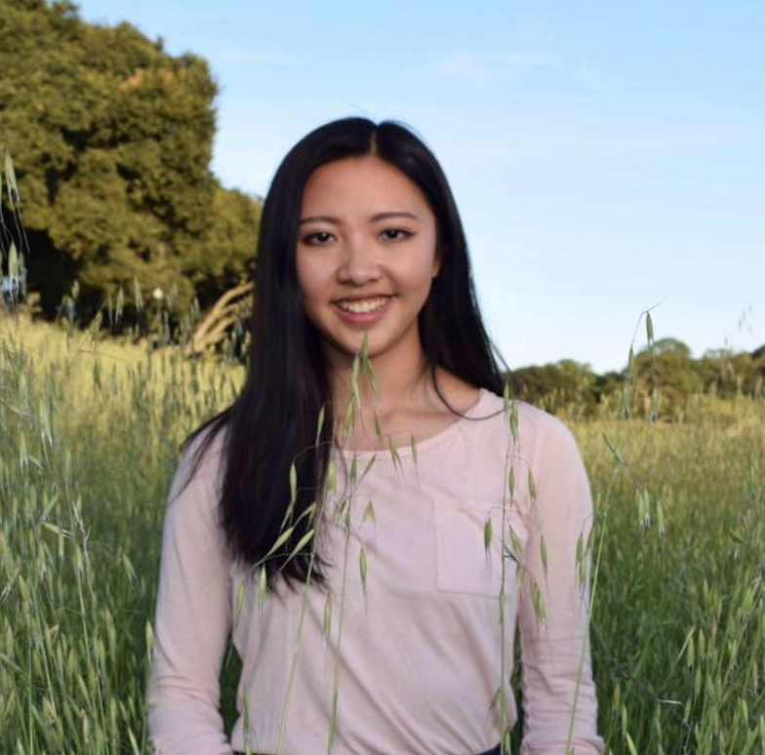
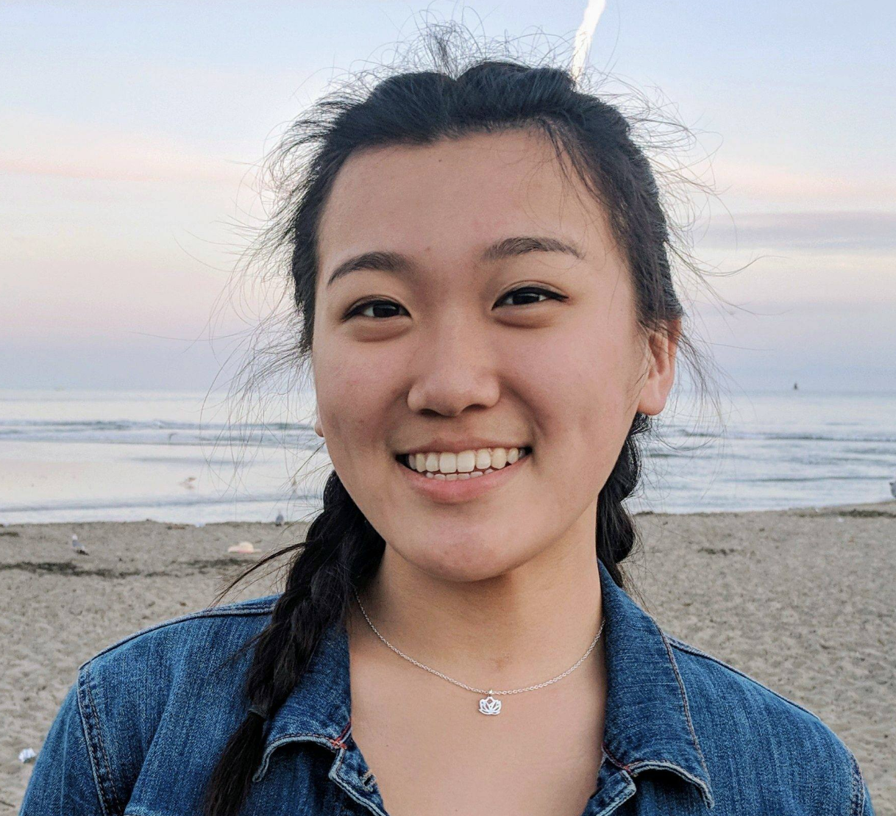
Meet the Team
Taylor Bacon
Chloe Barreau
Cynthia Liang
Jenny Zhi

Slide 3
changes
method
results
discussion
participants
apparatus
procedure
tasks
test measures
UI
value
testing

Slide 4
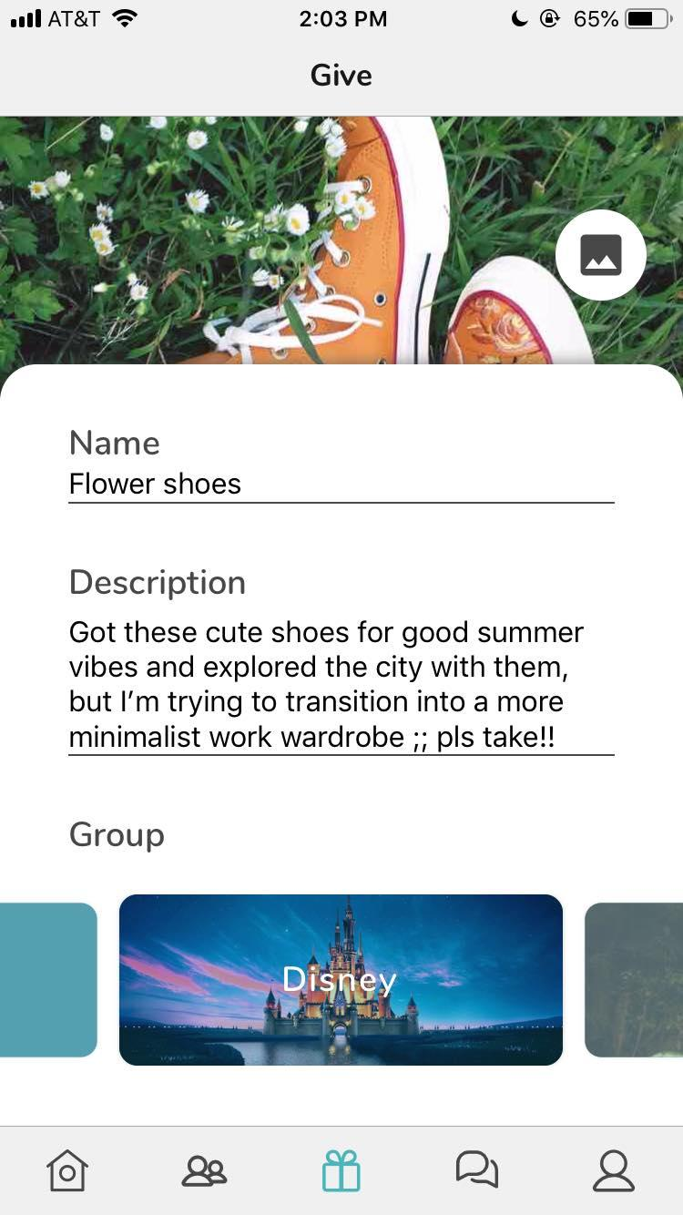
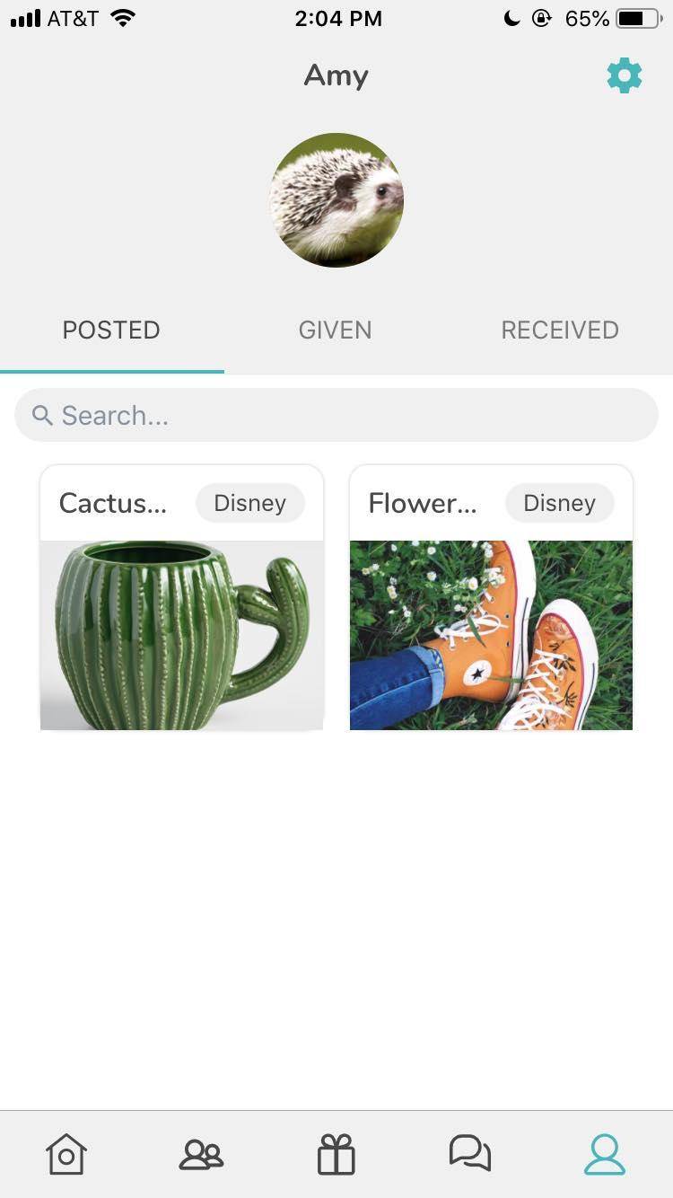
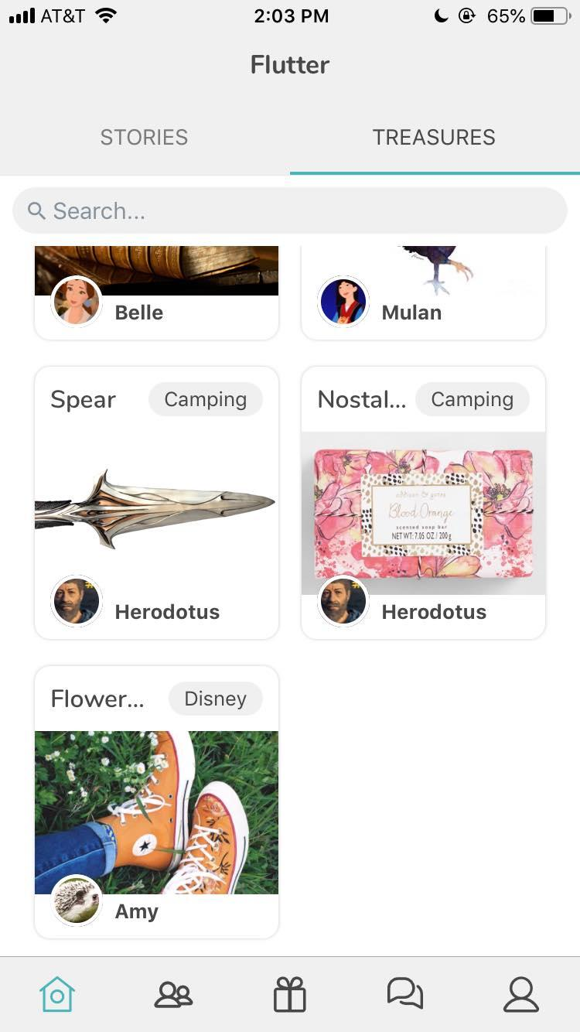
changes
method
results
discussion
Posting items

Slide 5
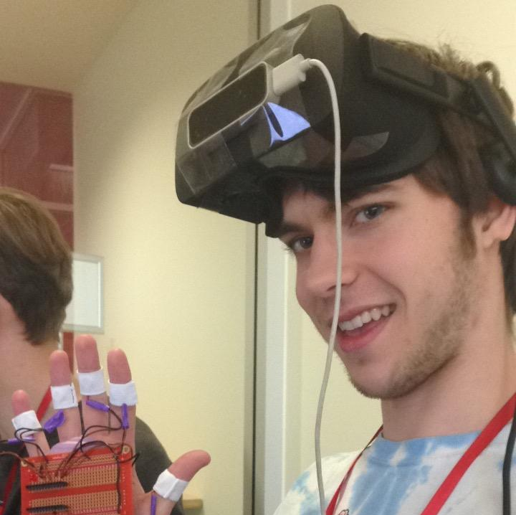
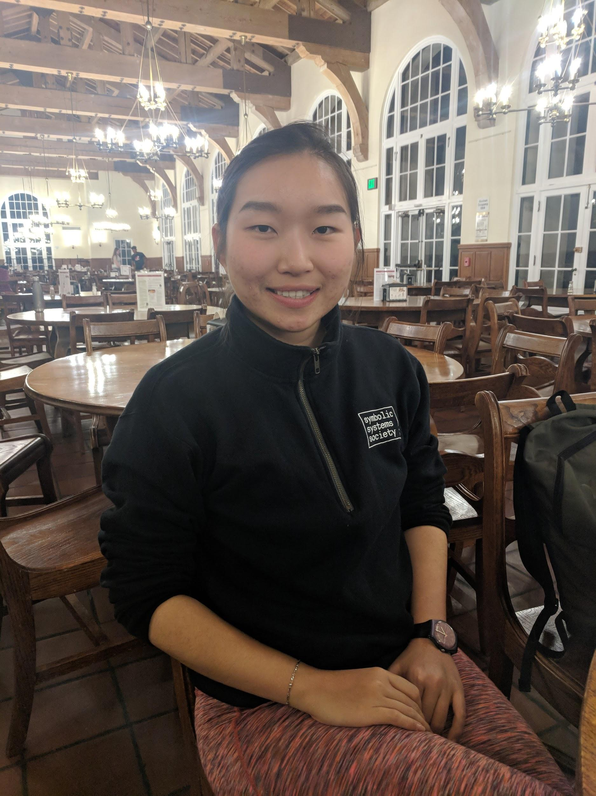
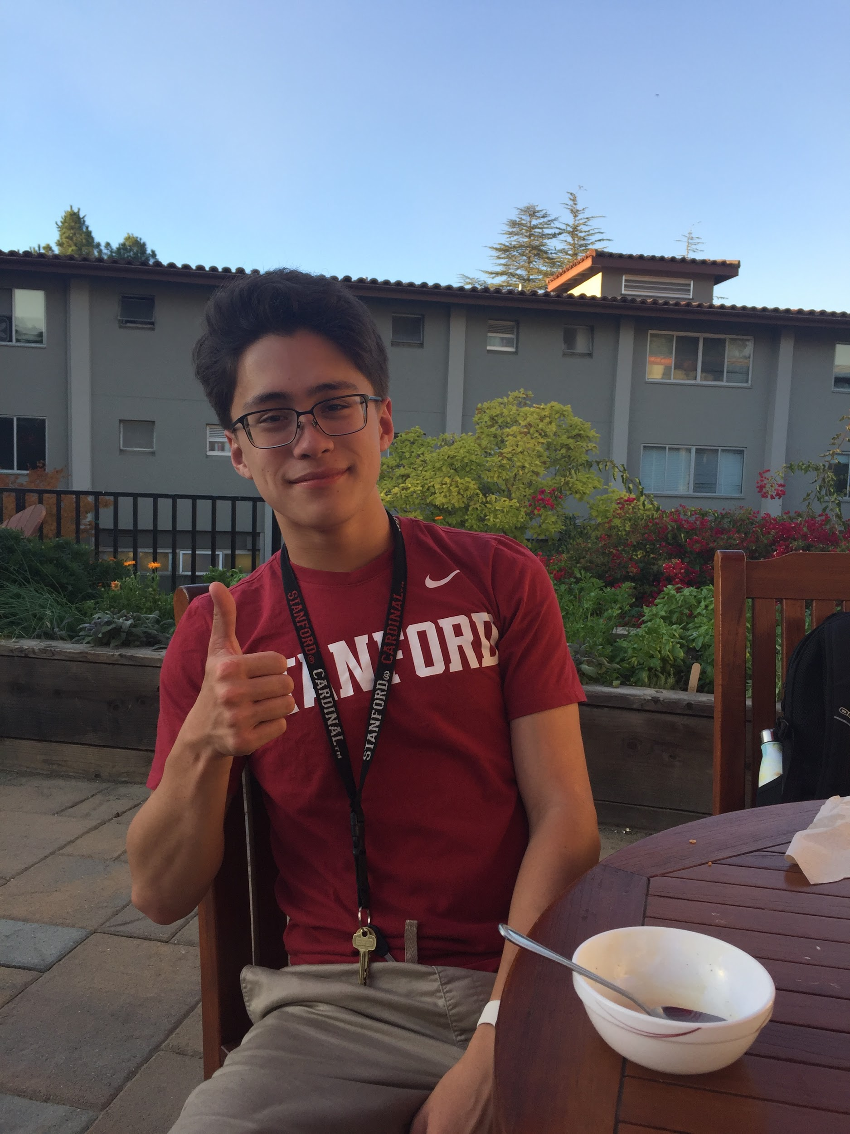
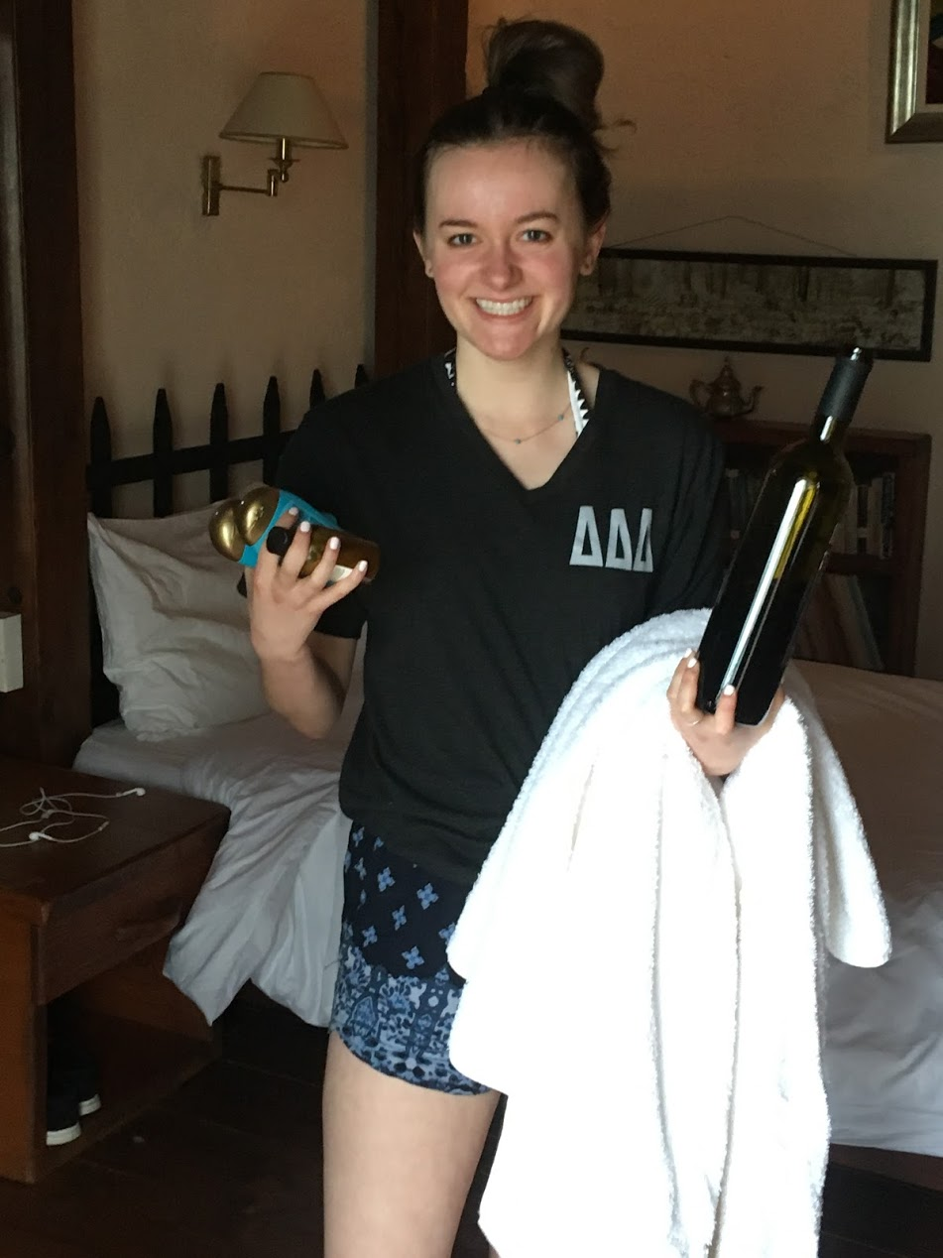
changes
method
results
discussion
participants
apparatus
procedure
tasks
test measures
Connor
19, M
Tinkerer & creator
= lots of stuff
Laura
22, F
Minerva student
constantly moving around
Will
18, M
Stanford band
= lots of weird gear
Sarah
22, F
“Basically a hoarder”, according to roommate

Slide 6



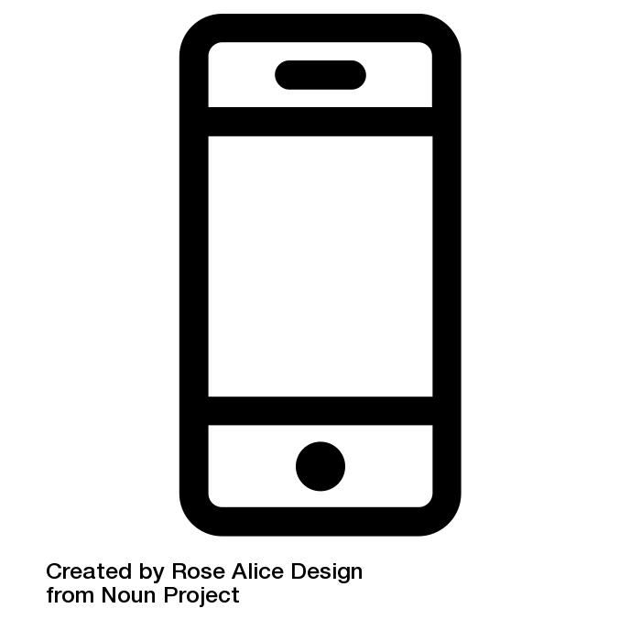
changes
method
results
discussion
participants
apparatus
procedure
tasks
test measures
ran prototype using Expo
recorded screen using Record It!
filmed using mobile phone cameras
ran tests in participants’ living areas

Slide 7
changes
method
results
discussion
participants
apparatus
procedure
tasks
test measures
Pre-test survey
demographic information
pictures & descriptions of sentimental but useless items
App introduction
brief explanation
demo of treasures and stories cards on home feed
Three tasks
find an object in a group
post an object (using one of tester’s own objects)
complete the unfinished story of a received object
Debrief & comments

Slide 8
changes
method
results
discussion
participants
apparatus
procedure
tasks
test measures
Find an object (simple)
“Find the spear in the camping group that you’re a part of.”
Post an object (medium)
“Post one of your objects.”
Share your story with a received object (complex)
“You recently received a scarf. Reciprocate your side of the object’s story.”

Slide 9
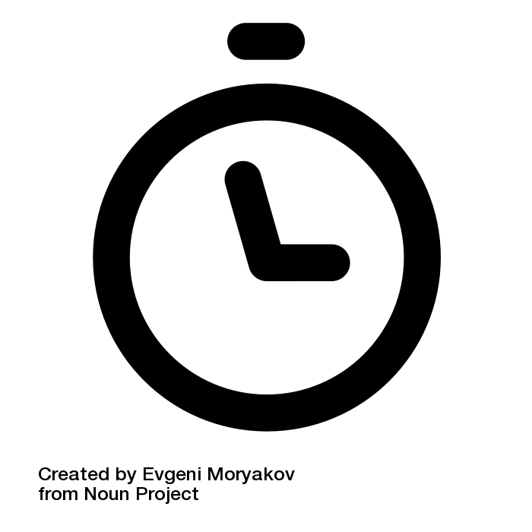



changes
method
results
discussion
participants
apparatus
procedure
tasks
test measures
Time it takes to complete a task
Number of times user makes an error
Number of times user hesitates or expresses confusion
Comments about use and value

Slide 10
changes
method
results
discussion
Completion times
Task 1: find an object 0:46 (0:38 without 1:10 outlier)
Task 2: give an object 1:38
Task 3: share stories 1:36
Common errors & confusion
Didn’t upload images (tasks 2 & 3)
Hesitation in finding object (task 3)
Thoughts on value - will get to this later

Slide 11
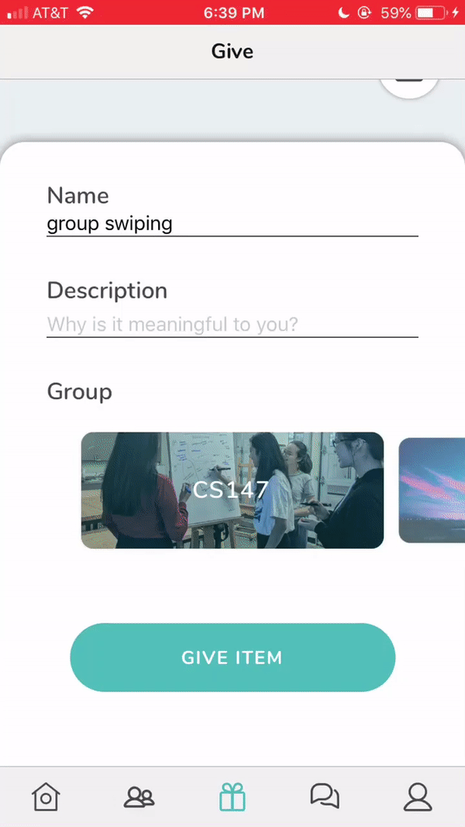
changes
method
results
discussion
UI
value
testing
Changes
Consider using just text with a dropdown. If we want to retain image clues/information, condense card size and spacing.
Issue
When posting an item, selecting a group is wonky and has the potential to be troublesome if an user is part of many groups.

Slide 12
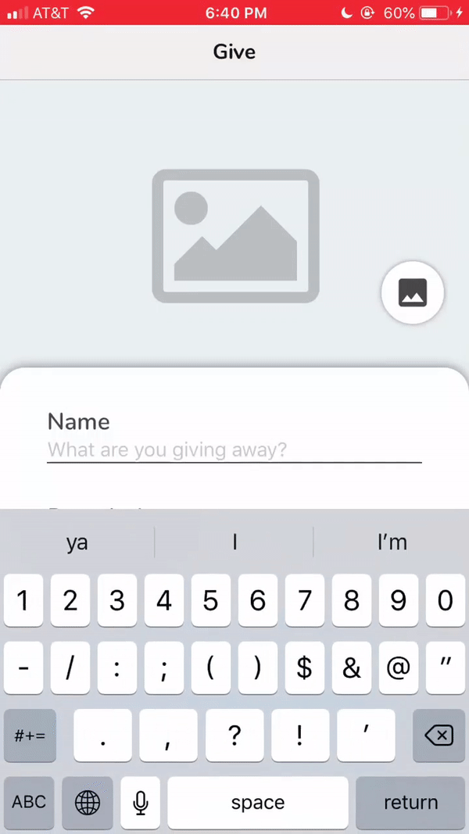
changes
method
results
discussion
UI
value
testing
Changes
Look into existing keyboard exit paradigms for multiline input boxes. Follow them.
Issue
After completing an item description, many users had trouble getting out of the keyboard.

Slide 13
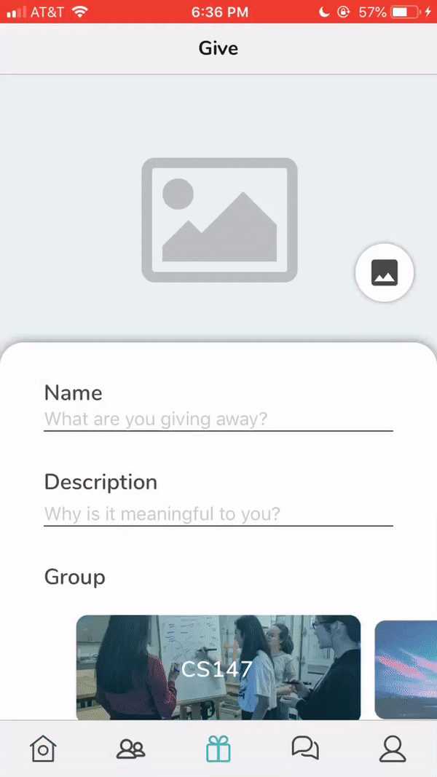
changes
method
results
discussion
UI
value
testing
Issue
Users can post items and stories without entering all necessary information (photo, title, description).
Changes
Error handling! This will make for a more seamless experience.

Slide 14
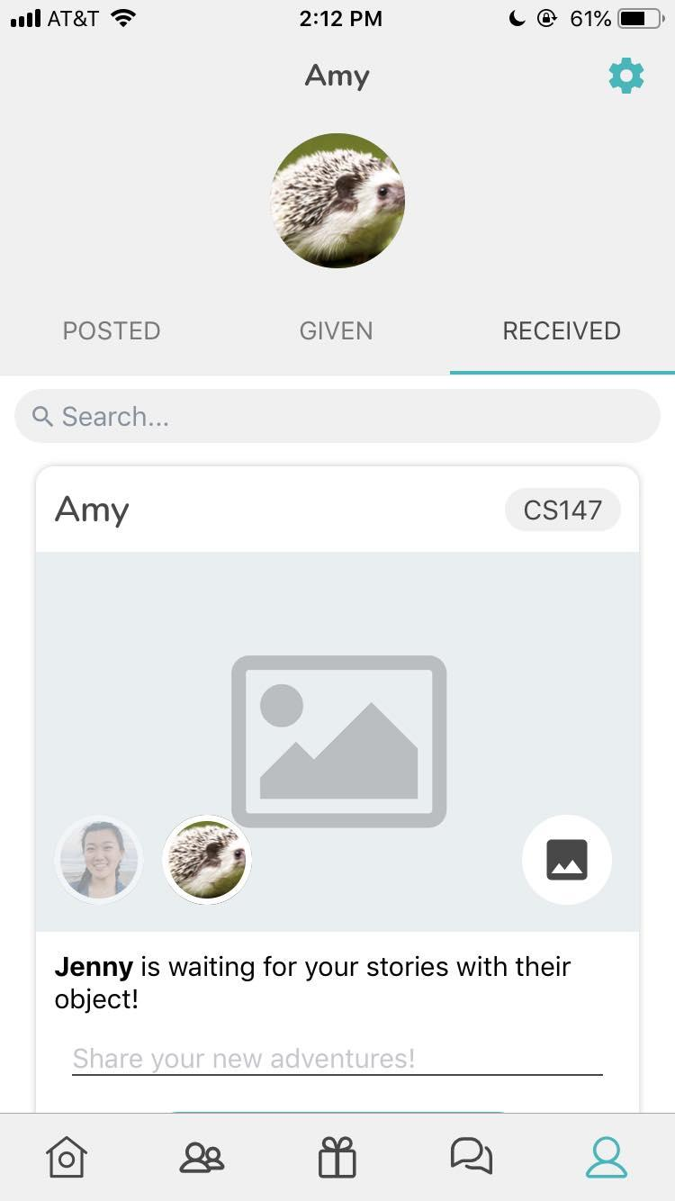
changes
method
results
discussion
UI
value
testing
Issue
Users had trouble starting on the third task. It wasn’t intuitive to go to profile to find received items.
Changes
Implement a notification system to prompt users to complete the stories of received objects.

Slide 15
changes
method
results
discussion
UI
value
testing
Potential additions
Make posting stories optional -- expands user base & use cases
Keep track/count of user’s interaction & reciprocation for quality control
Point system
Requirement to post/claim item
Allow for transaction/selling and valuation of items
Insights from testers
Three mentioned alternate uses that were situation-specific
Would like to use for mass decluttering/decluttering of utility objects without stories
Concerned with quality control of items
Not willing to just give away items with high monetary value

Slide 16
changes
method
results
discussion
UI
value
testing
To test next time
Two-way interactions
Workflow to messages and beyond
Giving and closing interaction
Wider range in demographics

Slide 17
Summary
Polished UI and aesthetics
Attention to details to refine and perfect user experience
Possibility of altering scope/intensity to expand user base and use cases
Prepare to test two-way interactions
any questions?

